Slide 1

RAFT: Recurrent All-Pairs Field Transforms for Optical Flow
Realise par
Ahmed Gharsallah
Hraghi Arij
Jihene Ben tekaya

Slide 2
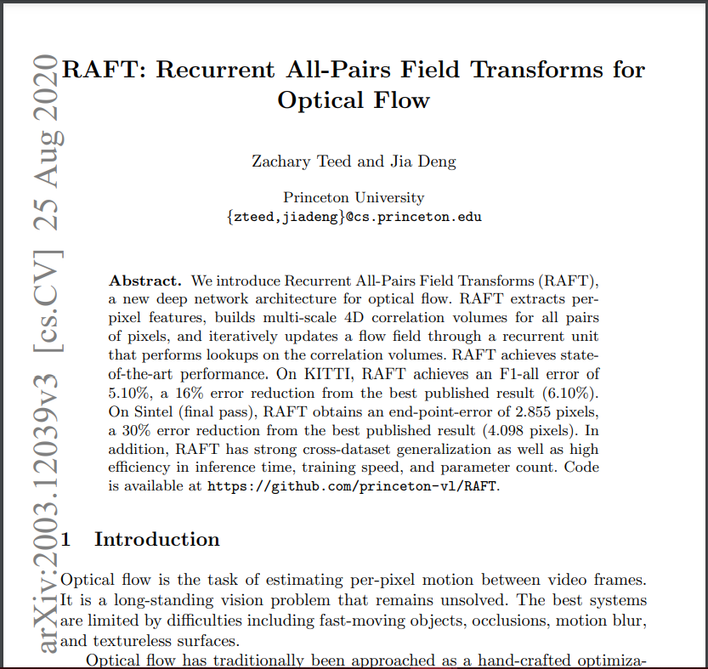
content
Introduction
Why choose RAFT
Architecture
Demo

Slide 3
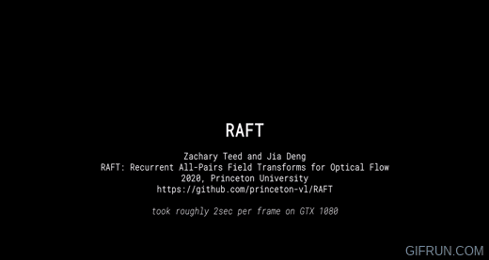
introduction

Slide 4

introduction
difficulties in hand-designing an optimization objective that is robust to a variety of corner cases
DEEP LEARNING
PROMISING ALTERNATIVE
Recurrent All-Pairs Field Transforms (RAFT), a new deep network architecture for optical flow.

Slide 5
WHY CHOOSE RAFT?

Slide 6
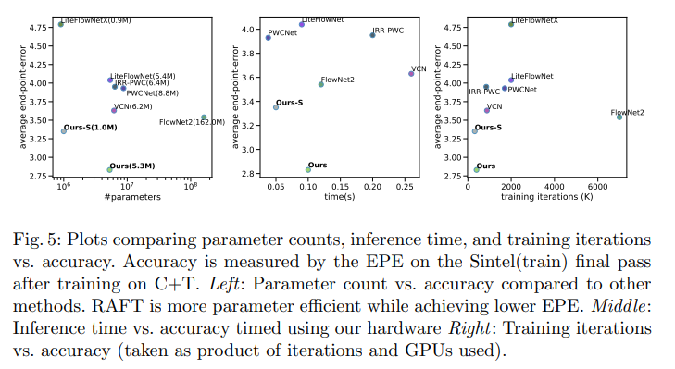

Slide 7
ARCHITECTURE

Slide 8
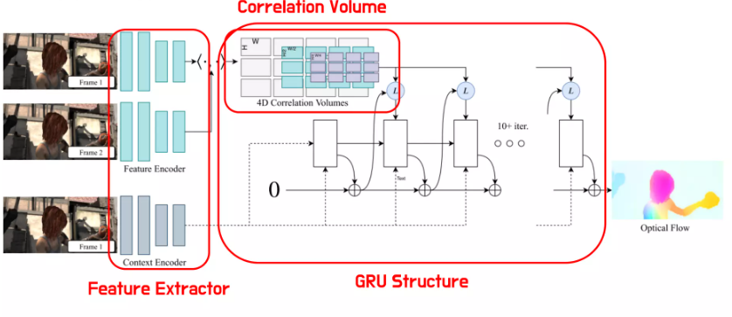
Architecture

Slide 9
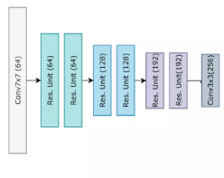
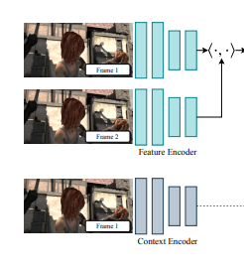

Feature Extraction
NETWORK ARCHI
maps the input images
to dense feature maps
at a lower resolution
RGB images, I1, I2
Feature Encoder extracts per-pixel features from both input images
a context encoder that extracts features from only I1.

Slide 10
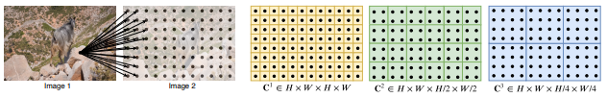
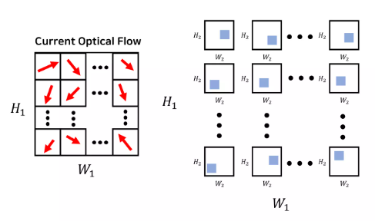
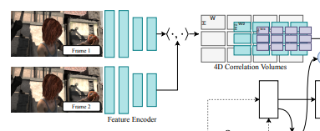









Computing Visual Similarity
Correlation Pyramid
Correlation Lookup
Efficient Computation for High Resolution Images
½ ¼
4-layer pyramid {C1 , C2 , C3 , C4}
dot product between all pairs of feature vectors.
perform lookups on all levels of the pyramid
(use neighborhood)

Slide 11
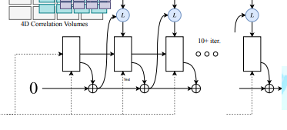
Iterative Updates:
Optical flow is initially predicted at 1/8 resolution
Upsampling is performed(mask)
A softmax operation is applied over a 3x3 grid
The input feature map is the concatenation of correlation, flow, and context features
we initialize the flow field to 0
final high-resolution flow field
The update operator includes a gated activation unit based on the GRU cell, employing convolutional layers.
Input from the context network is directly injected.

Slide 12
DEMO

Slide 13
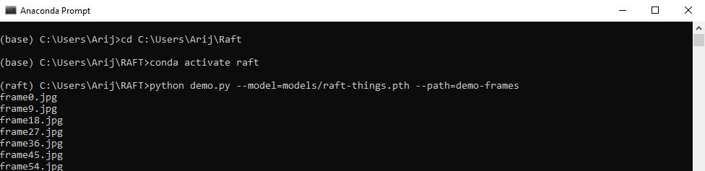
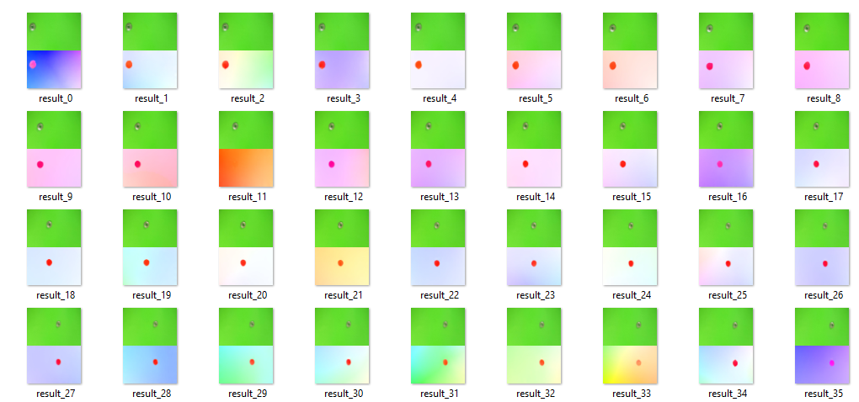
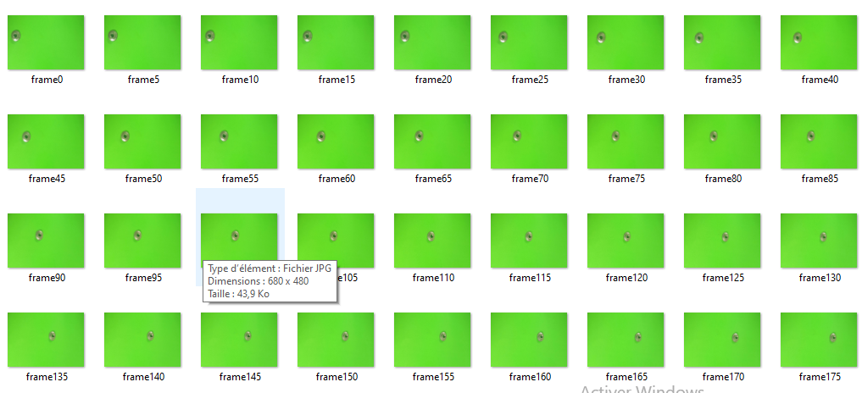

Slide 14
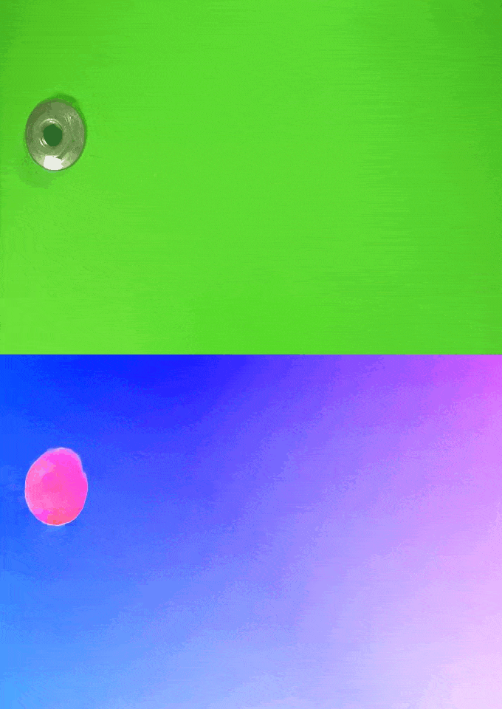
EXPERIMENTS

Slide 15
THANK YOU!

